Slide 2
Our Solution
Genetic Programming
Post-order parse tree
Evolve edge selection phase

Slide 3
Random Graph Generating Algorithm
Select vertices for new vertex to connect to
Add vertex
Add edges
n times
End

Slide 4
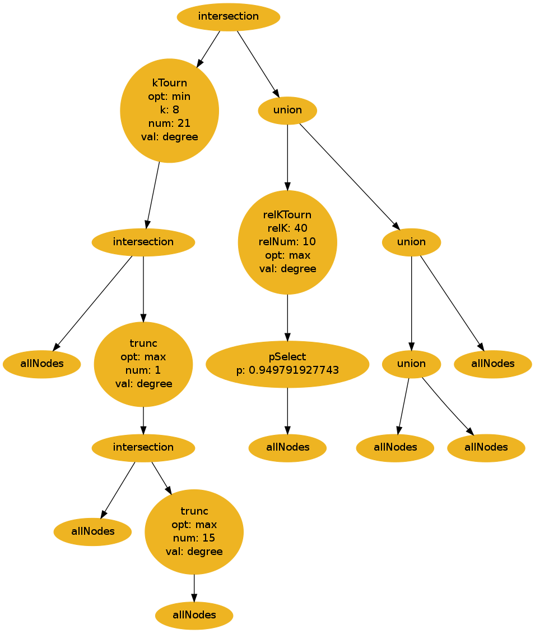
Parse Tree
Selects vertices for the new vertex to connect to
Sets of vertices
Root returns the set of vertices

Slide 5
Nodes: Selection Operations
Regular Selection
Relative Selection

Slide 6
Nodes: Regular Selection Operations
p-Select
k-Tournament Selection
Truncation Selection
Random Subset

Slide 7
Nodes: Relative Selection Operations
Relative k-Tournament Selection
Relative Truncation Selection
Relative Random Subset

Slide 8
Nodes: Set Operations
Union
Intersection
Difference
Symmetric Difference

Slide 9
Genetic Program
Generate Children
Evaluate Children
Generate Population
Evaluate Population
Parent Selection
Terminate
Check Termination
Survivor Selection

Slide 10

Random Graph Generating Algorithm Evaluation

Slide 11
Random Graph Generating Algorithm Evaluation

Slide 12
Testing
Maximize Edgecut of Partition
Minimize number of Edges
Minimize Edgecut of Partition
Maximize number of Edges
Maximize Average Eccentricity
Minimize number of Edges
Minimize Average Eccentricity
Minimize number of Edges

Slide 13
Testing
Trained Graph Size = 300
20 runs during evaluation
5 runs of GP on each problem

Slide 14
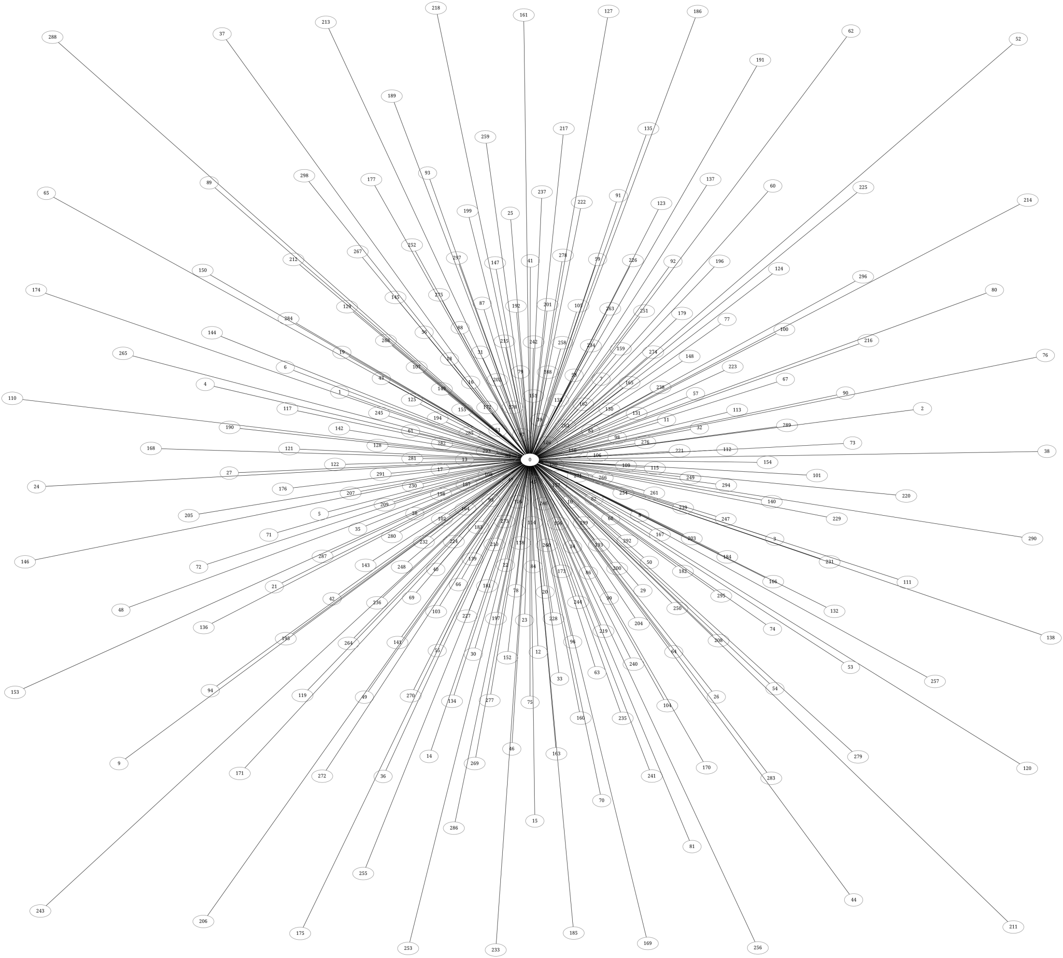
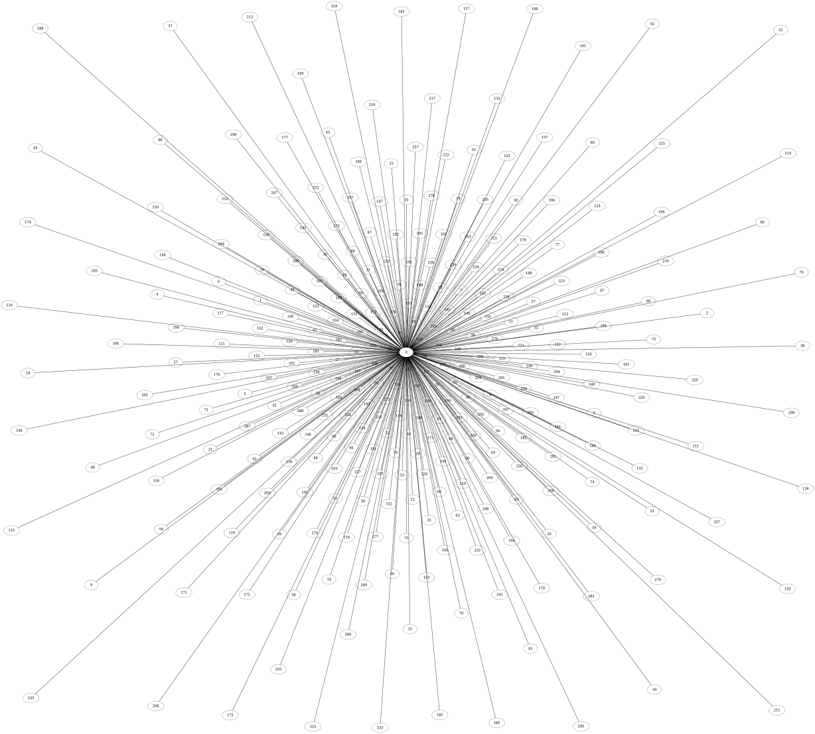
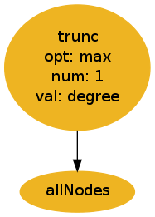
Results: Max Partition
Star Graph

Slide 15
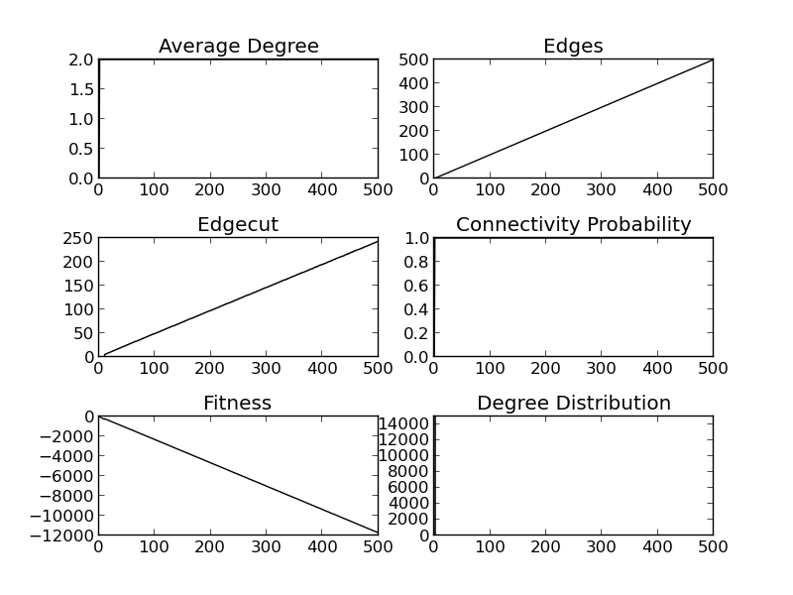
Results: Max Partition

Slide 16
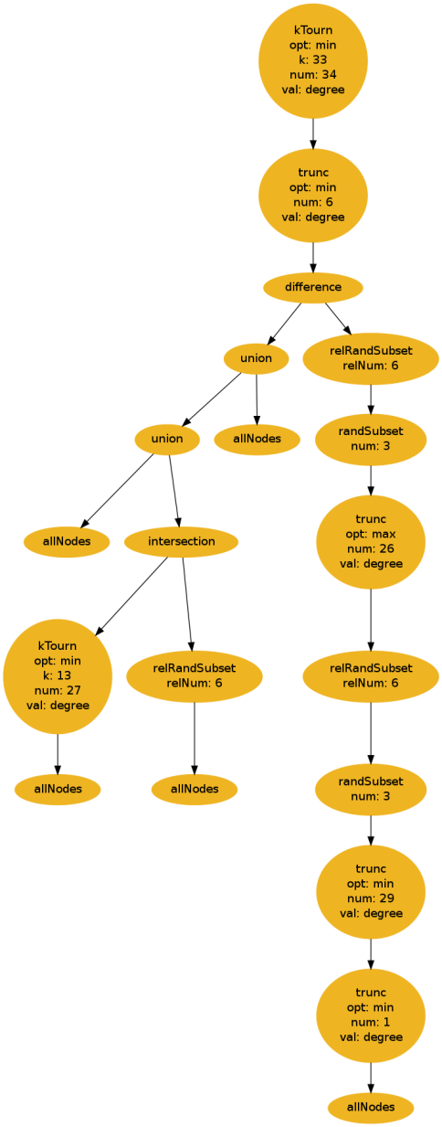
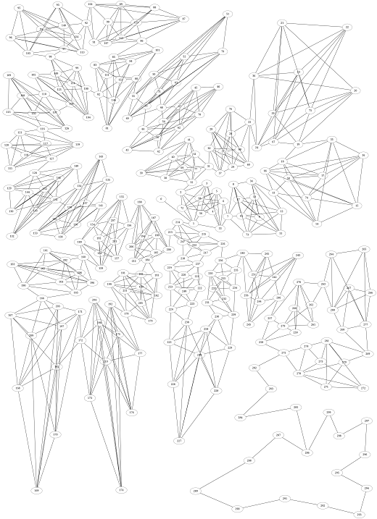
Results: Min Partition

Slide 17
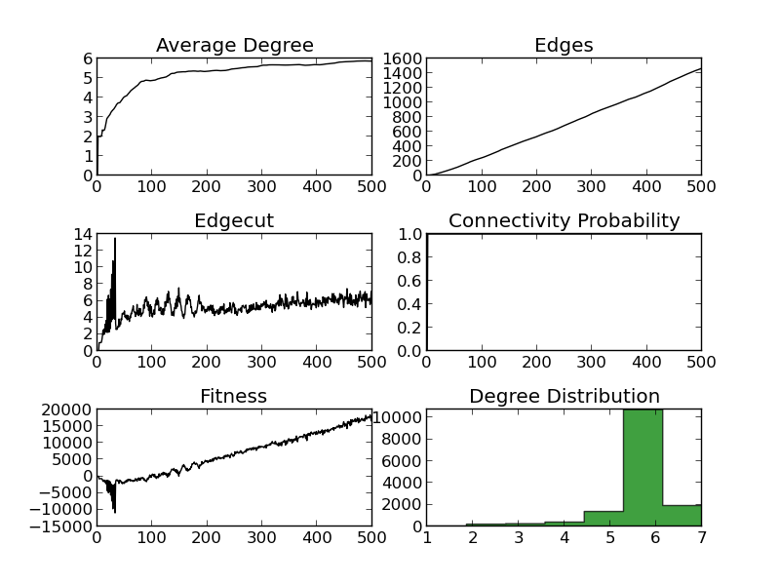
Results: Min Partition

Slide 18
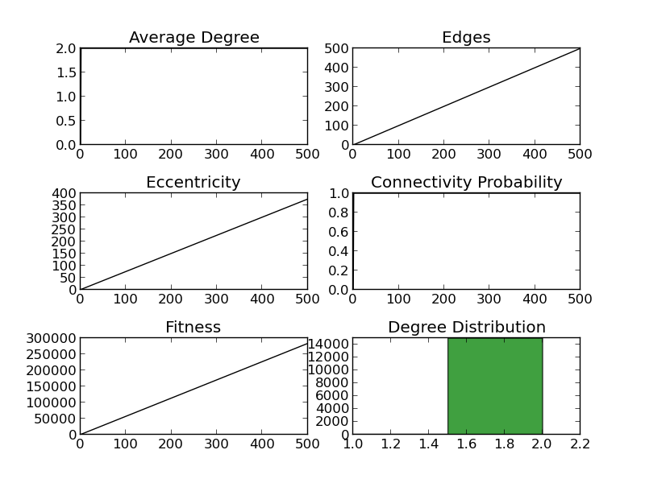
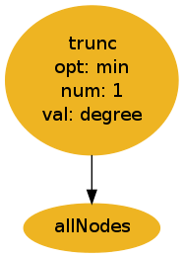
Results: Max Eccentricity
Path Graph

Slide 19
Results: Min Eccentricity
Star Graph

Slide 20
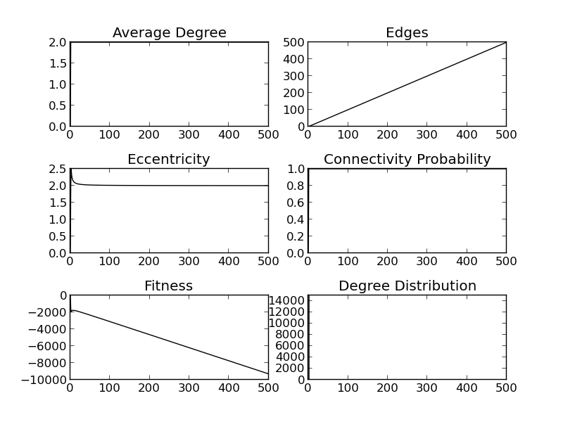
Results: Min Eccentricity

Slide 21
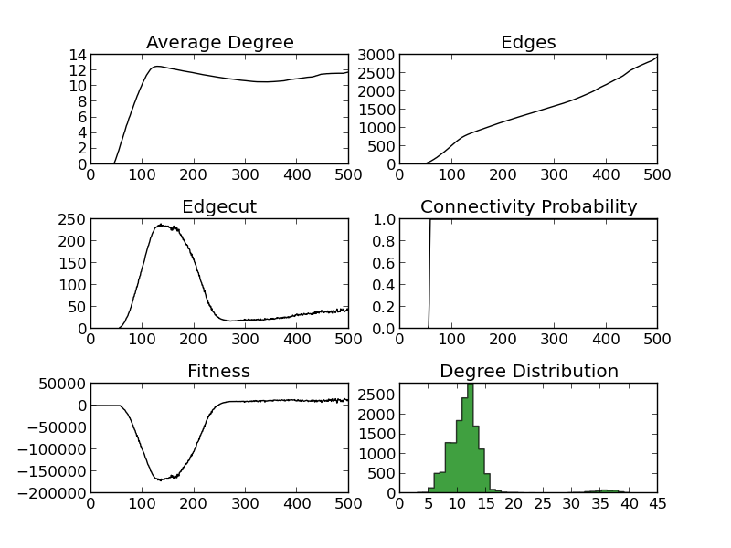
Drawbacks
Over-fitting

Slide 22
Future Work
Add capability to evolve Random Directed Graph Generating Algorithms
Use to create graphs that emulate program control flow graphs

Slide 23
Conclusion
Using GP we can create custom Random Graph Generation Algorithms
Proof of Concept
Improvement need on evaluation during evolution

